Slide 1
ECMA Script 6
Anil K

Slide 2
Introduction to ES6
"JavaScript 6" version in released in 2015, which is also called as "EcmaScript 6 or ES 6".
JavaScript 6 is the superset of JavaScript 5, which contains the following new features:
1. Classes
2. Constructors
3. Inheritance
4. Method Overriding
5. Set and Get Methods
6. Default Arguments
7. Arrow Functions
8. Let
9. Const
10. Rest
11. Destructuring
12. Multiline Strings
13. String Interpolation
14. Reading Elements from Array

Slide 3
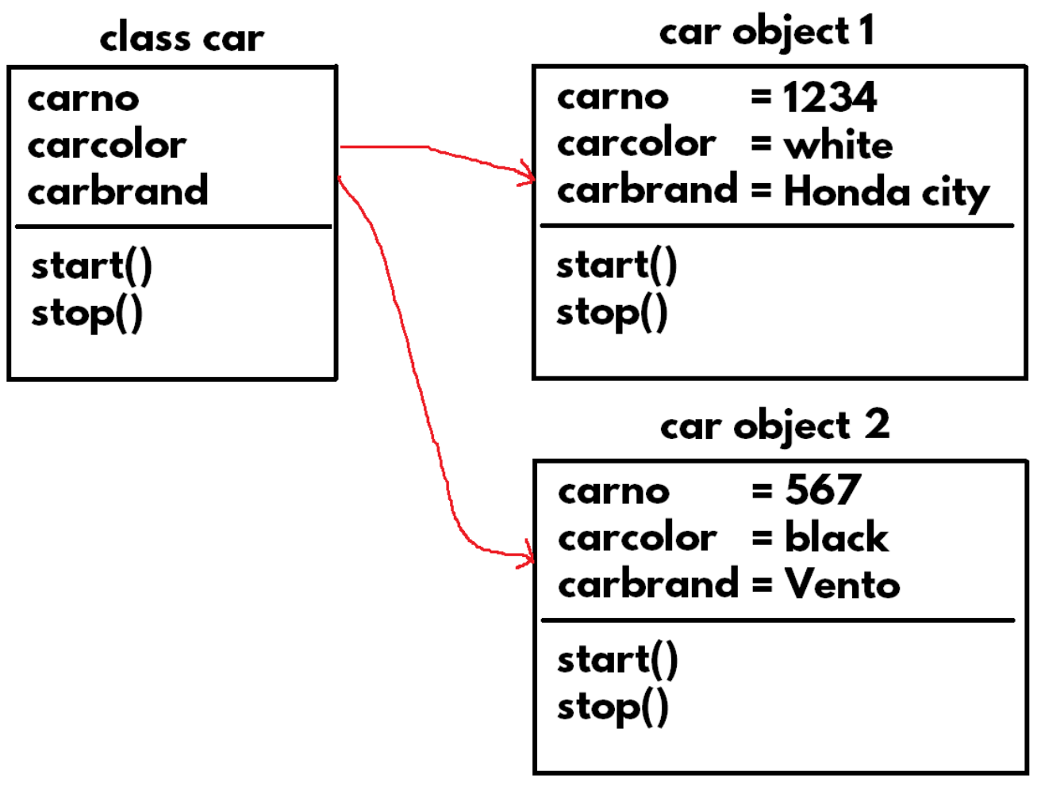
Classes
"Object" is a "physical item", which is a collection of properties (details) and methods (manipulations).
"Class" is a "model" of objects, which defines the list of properties and methods of the objects.

Slide 4
Steps for working with Classes and Objects
Create a class
class classname
{
}
Create an object
new classname();
<html>
<head>
<title>Classes</title>
</head>
<body>
<h1>Classes</h1>
<script>
class Student { }
var s = new Student();
console.log(s);
</script>
</body>
</html>

Slide 5
Constructors
Constructor is a special method in the class, that executes every time when we created an object for the class.
Constructor's name should be "constructor".
Constructor can receive arguments; but can't return any value.
It is not possible to call the constructor without creating an object.
Constructors are mainly used to create an initialize properties in the class.
Parameterized Constructor is a constructor that receives one or more arguments (parameters) and initializes the same to the respective properties.
Syntax of Constructor
class classname
{
constructor(arguments)
{
}
}

Slide 6
Example on Constructors
<html>
<head>
<title>Constructors</title>
</head>
<body>
<111>Constructors</h1>
<script>
class Student {
constructor() {
this.studentid = 101;
this.studentname = "Scott";
this.marks = 70;
}
}
var s = new Student();
console.log(s.studentid);
console.log(s.studentname);
console.log(s.marks);
</script>
</body>
</html>

Slide 7
Example on Parameterized Constructors
<html>
<head>
<title>Parameterized Constructor</title>
</head>
<body>
<h1>Parameterized Constructor</h1>
<script>
class Student {
constructor(a, b, c) {
this.studentid = a;
this.studentname = b;
this.marks = c;
}
}
var s = new Student(201, "Smith", 80);
console.log(s.studentid);
console.log(s.studentname);
console.log(s.marks);
console.log(s.result());
</script>
</body>
</html>

Slide 8
Methods
Method is a function that manipulates data of the object.
Syntax of Method
class classname
{
methodname(arguments)
{
}
}

Slide 9
Example on Methods
<html>
<head>
<title>Methods</title>
</head>
<body>
<h1>Methods</h1>
<script>
class Student {
constructor(a, b, c) {
this.studentid = a;
this.studentname = b;
this.marks = c;
}
result() {
if (this.marks >= 35) {
return "Pass";
} else {
return "Fail";
}
}
}
var s = new Student(101, "Scott", 70);
console.log(s.studentid);
console.log(s.studentname);
console.log(s.marks);
console.log(s.result());
</script>
</body>
</html>

Slide 10
Inheritance
Inheritance is a concept of extending the parent class, by creating the child class.
When you create an object of child class, all the members of parent class will be automatically added to the child class's object.
Syntax of Inheritance
class parentclassname
{
constructor(arguments)
{
}
}
class childclassname extends parentclassname
{
constructor(arguments)
{
super(arguments);
}
}

Slide 11
Example on Inheritance
<html> <head>
<title>Inheritance</title>
</head> <body>
<h1>Inheritance</h1>
<script>
class Person {
constructor(name, age) {
this.name = name;
this.age = age;
}
}
class Student extends Person {
constructor(name, age, studentid, marks) {
super(name, age);
this.studentid = studentid;
this.marks = marks;
}
}
var s = new Student("scott", 20, 101, 78);
console.log(s.name);
console.log(s.age);
console.log(s.studentid);
console.log(s.marks);
</script>
</body> </html>

Slide 12
Method Overriding
Method Overriding is a concept of extending the "parent class method", by creating similar method in the "child class", with same signature (name and arguments).
Syntax of Method Overriding
class parentclassname
{
method(arguments)
{
}
}
class childclassname extends parentclassname
{
method(arguments)
{
super.method(arguments);
}
}

Slide 13
Example on Method Overriding
<html> <head>
<title>Method Overriding</title>
</head> <body>
<h1>Method Overriding</h1>
<script>
class Person {
constructor(name, age) {
this.name = name; this.age = age;
}
display() {
return "name is " + this.name + ", age is " + this.age;
}
}
class Student extends Person {
constructor(name, age, studentid, marks) {
super(name, age);
this.studentid = studentid;
this.marks = marks;
}
display() {
return super.display() + ", studentid is " + this.studentid + ", marks is " + this.marks;
}
}

Slide 14
class Employee extends Person {
constructor(name, age, employeeid, salary) {
super(name, age);
this.employeeid = employeeid;
this.salary = salary;
}
display() {
return super.display() + ", employeeid is " + this.employeeid + ", salary is " + this.salary;
}
}
var s = new Student("scott", 20, 101, 78);
console.log(s.display());
var e = new Employee("smith", 25, 201, 9500);
console.log(e.display());
</script>
</body> </html>

Slide 15
Set and Get Methods
The "set" method executes automatically when we assign a value into the accessor. It performs validation and assigns the value into the property, if it is valid.
The "get" method executes automatically when we retrieve the value from the accessor. It returns the current value of the property

Slide 16
Steps for working with Set Method and Get Method
Create Set Method
set accessorname(argumentname)
{
this.property = argumentname;
}
Create Get Method
get accessorname(argumentname)
{
return this.property;
}
Call Set Method
accessorname = actualvalue;
Create Get Method
accessorname

Slide 17
Example on Set and Get Methods
<html> <head>
<title>Set and Get Methods</title>
</head> <body>
<h1>Set and Get Methods</h1>
<script>
class Person {
constructor() {
this.name = null;
this.age = 0;
}
set Name(value){
if (value.length <= 20) {
this.name = value;
}
}
get Name() {
return this.name;
}
set Age(value) {
if (value >= 18 && value <= 70) {
this.age = value;
}
}
get Age() {
return this.age;
}
}

Slide 18
var p = new Person();
p.Name = "abcdefghijklmnopqrstuvwxyz";
p.Age = 800;
console.log(p.Name);
console.log(p.Age);
p.Name = "Scott";
p.Age = 30;
console.log(p.Name);
console.log(p.Age);
</script>
</body> </html>

Slide 19
Default Arguments
Default Arguments are used to provide a default value for the method of a parameter.
When we call the method and don’t supply a value for the parameter, the specified default value will be assigned to the parameter automatically.
Steps for working with Default Arguments
method(argument = defaultvalue)
{
}

Slide 20
Example on Default Arguments
<html>
<head>
<title>Default Arguments</title>
</head>
<body>
<h1>Default Arguments</h1>
<script>
class sample {
methodl(x = 100) {
console.log(x);
}
}
var s = new sample();
s.methodl(200);
s.methodl();
</script>
</body>
</html>

